Slide 1
Tax Compliance
Nguyen Xuan Thanh
Naypyitaw, 16 May 2017

Slide 2
Tax Noncompliance
Tax evasion
Use illegal means to evade paying their full tax liability.
Tax evaders choose not to report or to under-report their earned incomes, sales revenues, or wealth while they attempt to overreport the amount of deductible expenses or even participate in outright smuggling or money laundering schemes.
Tax avoidance
Taxpayers use loopholes in the existing tax regimes (take advantage of the provisions of the tax law) in order to lower their tax liability.

Slide 3
Determinants of Tax Noncompliance
Income taxes Consumption taxes
Trade taxes
Natural resource taxes
Internal Determinants
External Determinants
Complexity of Tax Policy
Accountability in Public Expenditures
Taxpayer Behaviors
Tax Administration
Legal Framework
Capacity
Efficiency
Integrity
Tax Evasion
Tax Avoidance
Corruption
Noncompliance
Shadow
Economy
Accounting & auditing systems
Revenue Leakage
More distortions
Less equitable
Compliance Cost
Transfer Pricing & Tax Havens

Slide 4
Complexity of Tax Policy
Excessively high rate structure and a nonfunctioning system of penalties for noncompliant behavior lead to tax evasion.
The complexity of tax codes and legislation is the driving force for tax avoidance. Unclear tax provisions create loopholes.

Slide 5
Tax Administration
Legal framework and institutional arrangements
Capacity
Efficiency
Integrity

Slide 6
Compliance Cost
The time (hours per year) taken to prepare, file and pay three major types of taxes and contributions: the corporate income tax, value added or sales tax, and labor taxes, including payroll taxes and social contributions.
Source: World Bank, Doing Business 2018.

Slide 7
Compliance Cost
Postfiling index is based on four components—time to comply with VAT refund, time to obtain VAT refund, time to comply with corporate income tax audit and time to complete a corporate income tax audit.
Source: World Bank, Doing Business 2018.

Slide 8
Accountability in Public Expenditures
The “fiscal social contract”
Willingness of a country’s citizens to pay taxes and therefore induce higher compliance only if they have, in return, the rights to be represented in the decision-making process about how public finance is raised and used.

Slide 9
Appeal and Review System
If people perceive that the appeal and review system is efficient and effective and there is a fair degree of equity in the treatment of taxpayers irrespective of their wealth or status, compliance is likely to be enhanced.
Independent appeals system capable of processing disputes between tax authority and taxpayer in a fair and timely manner.

Slide 10
Corruption
Source: Transparency International.

Slide 11
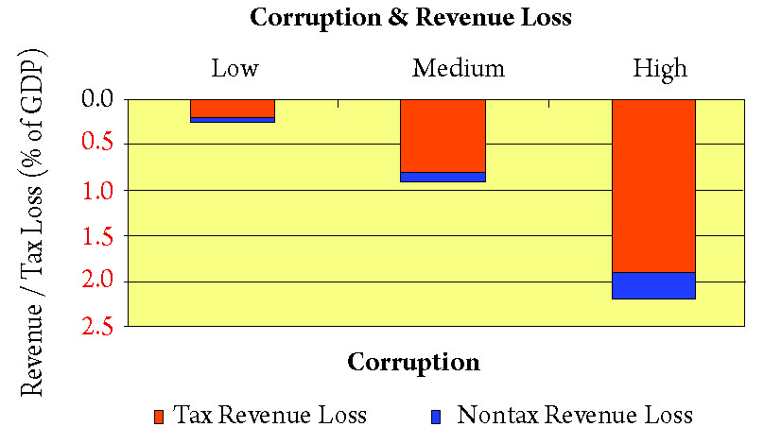
Higher Corruption Associated with Greater Revenue and Tax Loss
Source: Le, Pham, Kisunko, and Shukla (2008), Data for 1992-2002

Slide 12
Shadow Economy
The Bigger the Shadow Economy, the Greater the Tax Leakage
Size of Shadow Economy (% of GDP) |  | Tax Revenue Leakage (% of GDP)
Low | 17.6 | 3.5
Medium | 28.0 | 4.9
High | 35.7 | 6.1
Sources: Schneider and Klinglmair 2010

Slide 13
Accounting and Auditing Systems
Corporate tax noncompliance may be caused and/or exacerbated by:
Murky accounting systems (e.g. two accounting books – one for actual operation and one for tax reporting)
Incompatibility between accounting/auditing standards and tax filing requirements.
Incompatibility between local accounting/auditing standards and international ones (IFRS or IAS).
Reform in Local Accounting and Auditing Standards
Uniformity and standardization
Harmonization with international standards
Independent audits
Capital market development and economic integration
Stock market development with more listed firms increase transparency and compliance
Openness to trade and economic integration put pressure on local firms to improve their accounting systems.

Slide 14
Transfer Pricing
Multinational companies can exploit the complexities of transfer pricing to lower their tax liabilities.
A multinational company has entities that are under the same ownership but operate in different tax jurisdictions.
Transfer pricing is the practice by which a multinational company determines the prices charged for goods and services exchanged between their related entities in order to minimize their tax payments.
More and more countries start to adopt and enforce transfer pricing rules (e.g. cost-sharing, cost inclusion).

Slide 15
Tax Havens
Tax havens: countries or territories where taxes are assessed at a low or zero rate.
Large companies and wealthy individuals can use tax havens to lower their income tax payments.
Developing countries have almost no ability to tackle the use tax havens to avoid taxes.
Even advanced countries are very slow to tackle tax havens following the publication of the Panama papers.

Slide 16
Jade Taxation in Myanmar
Note: Value is estimated using the 2011 market exchange rate of 800 K/$.
Source: David and Thanh (2013)

Slide 17
Increase Tax Compliance and Tax Revenue Collection from Jade
Transparent licensing with decision-making power rests with both the Union Government and the Kachin State
Competitive bidding for new sites
Letting existing mining licenses expired
Lower and simpler tax structure
Encourage private investment (both foreign and domestic)
Discourage informal exports
State-level supervision of land reclamation and mine closure
Resource sharing
Tax revenue to the Kachin State
Investments in physical and social infrastructures
State Trust Fund
Tax revenue to the Union Government
Tax revenue to other states

