Slide 1
Fiscal Decentralization
Vu-Thanh Tu-Anh
Naypyitaw, 17 May 2018

Slide 2
Presentation structure
What is fiscal decentralization?
Why (fiscal) decentralization?
Fiscal decentralization cases:
China
Vietnam
Results of fiscal decentralization

Slide 3
Defining decentralization
Decentralization is the transfer of power and responsibility from the central government to local governments, or the assignment of such tasks to the private sector.
Fiscal decentralization:
Expenditure and revenue responsibilities
Intergovernmental transfers
Local revenue mobilization
Local government borrowing
[Fiscal federalism and public choice]

Slide 4
Disintegrating decentralization
CENTRAL
De-concentration
Delegation
Devolution
Political
Formulation/Planning
Phân cấp chính trị
Phân cấp chính trị
Administrative
Financing
Phân cấp hành chính
Phân cấp hành chính
LOCAL
Implementation
Fiscal
Phân cấp ngân sách
Phân cấp ngân sách
Monitoring/Control
Market
Phân cấp thị trường
Audit/Evaluation

Slide 5
Fiscal decentralization
Fiscal decentralization lies at the heart of decentralization
Who generates and who allocates the resources?
Degree of fiscal decentralization
Local governments’ power and autonomy in revenue and expenditure
Local share in total revenue
Local share in total expenditure
Transfer between central and local governments

Slide 6
Why decentralization: Theory
Stigler (1957):
representative government works best closer it is to the people
people should have the right to vote for the kind and amount of public service they want
Oates (1972): “each public service should be provided by the jurisdiction having control over the minimum geographical area that would internalize benefits and costs of such provision”
WB (2010): The transfer of authority and responsibility from the central to local government brings the decision-making authority closer to the people, enhances efficiency, equity, transparency, and accountability of the public sector

Slide 7
Why decentralization? Practical reasons
History
Experience of highly centralized countries
Central government overloaded and ineffective
Ethnic and religious conflicts
Economics
Efficiency
Effectiveness
Sustainability
Flexibility – “glocalization”
Politics
Increasing the participation of minorities
Preserving the federal system (state preservation)
7

Slide 8
Case study: China Total tax revenue and central revenue
Chunli Shen, Jing Jin, Heng-fu Zou (2012). Fiscal Decentralization in China: History, Impact, Challenges and Next Steps

Slide 9
Revenue sharing in China’s 1994 reform
 | Central (%) | Local (%)
CENTRAL TAXES
Tariffs | 100 | 0
Consumption Tax | 100 | 0
SHARED TAXES
VAT | 75 | 25
Business Tax | 3 | 97
Stamp Tax on Security Exchange | 97 | 3
Personal Income Tax | 60 | 40
Company Income Tax | 60 | 40
LOCAL TAXES
Resource Tax | 0 | 100
Urban Maintenance and Development Tax | 0 | 100
Urban Land Using Tax | 0 | 100
Agriculture and Related Tax | 0 | 100
Tax on Contracts | 0 | 100
Tax on the Use of Arable Land | 0 | 100
Vehicle Purchasing Tax | 0 | 100
Chunli Shen, Jing Jin, Heng-fu Zou (2012). Fiscal Decentralization in China: History, Impact, Challenges and Next Steps

Slide 10
Case study: Vietnam Revenue sharing arrangement
100% central gov’t | Shared revenues | 100% provincial gov’t
Trade taxes | VAT (except VAT on imports) | Land and housing taxes
VAT and Excise on Imports | CIT (except central enterprises) | Natural resource taxes (exc. Petroleum)
Taxes and other revenue from petroleum | Personal Income Tax | License taxes
CIT on central enterprises | Excise on domestic goods and services | Tax on transfer of land use rights
 | Gasoline and oil fees | Fees on land use
 |  | Land rent
 |  | Lease and sale of state property
 |  | Fees and charges (non-tax)

Slide 11
Expenditure assignment
Expenditure assignment between the central and local governments commensurates with the geographical area that benefits from the expenditure.
Central gov’t is responsible for national and inter-provincial programs, projects and services (major irrigation projects, flood control and dike construction, national highways, higher education)
Local gov’ts are responsible for services that benefit their geographical boundaries (maintenance and repair of small irrigation works and roads outside national highways, primary and secondary education)

Slide 12
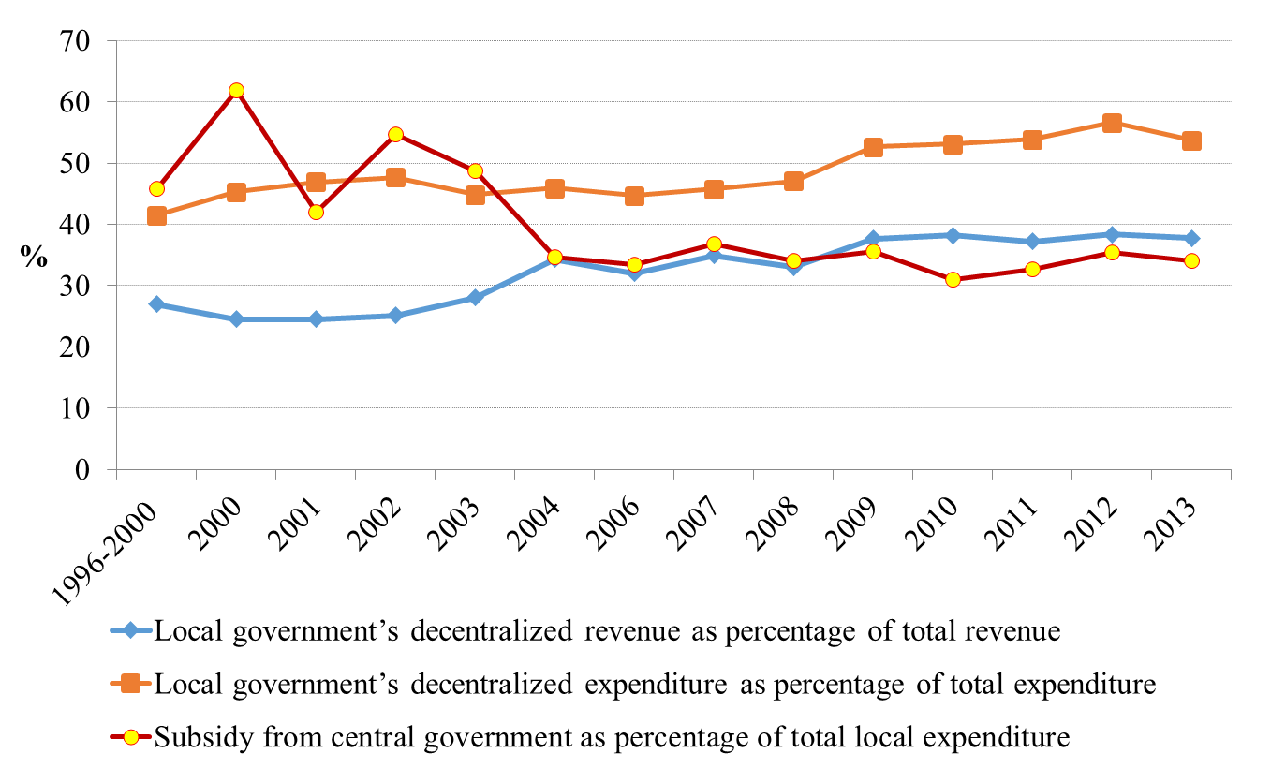
Local Revenue, Expenditure, and Central Transfers in Vietnam

Slide 13
Decentralization result: Failure
Design:
Competing (conflicting objectives)
Top-down decentralization
Implementation:
Unbalanced decentralization
Unfunded mandates
Decentralized power can be exploited
Measurement and evaluation problems
Notes:
Usually mixed results

Slide 14
Decentralization result: Success
Gradualism vs. “Big Bang”
Manageable scale and scope
One step at a time
Decentralizing with specific functions
Important complementary measures:
Political commitment
Matching financial and human resources with responsibilities
Appropriate incentives (tax sharing, grant transfers)
Other dimensions of decentralization

Slide 15
Some warnings
Results of fiscal decentralization is mixed
Political, economic, administrative system is self-sustaining, so it cannot be changed overnight
Decentralization can lead to instability, reduced efficiency, and increased corruption
Not suitable for countries / regions in serious crisis

Slide 16
CONTACT
Q&A
Fulbright School of Public Policy and Management
232/6 Vo Thi Sau, District 3, HCMC
T: (028) 3932 5103
F: (028) 3932 5104
E-mail: info.fsppm@fuv.edu.vn
Web: www.fsppm.fuv.edu.vn/

