Slide 1
Session 2: Review of Local Public Finance and Fiscal Decentralization for Myanmar
Du T. Huynh
Senior Lecturer, Fulbright School of Public Policy and Management
12-2020

Slide 2
Outline
Principles and framework
Fiscal decentralization in Myanmar

Slide 3
Part I: General Principles

Slide 4
Syllabus
Fiscal Decentralization
Fiscal Decentralization and Political Reforms
Local Revenue Systems
Local Government Borrowing, Fiscal Transfers

Slide 5
Fiscal Decentralization
Fiscal federalism and public choice
The political economy of fiscal decentralization
Decentralization challenges facing low and lower-middle income countries
Case Study Presentation (Yangon)

Slide 6
Fiscal Decentralization and Political Reforms
International trends in political, administrative and fiscal decentralization
Roles of central and sub-national governments
Allocation of expenditure and revenue responsibilities
Case Study Presentation (Naypyitaw)

Slide 7
Local Revenue Systems
Income taxation
Sales taxation
Property taxation
Excise tax
User charges, business taxation, license fees, and permits
Case Studies Presentation (Shan State, Bago Region)

Slide 8
Responsibilities among government levels
Issues within boundaries of a locatilty
Issues beyond boundaries of a locatilty
Power is the main matter.

Slide 9
Part II: Fiscal Decentralization in Myanmar

Slide 10
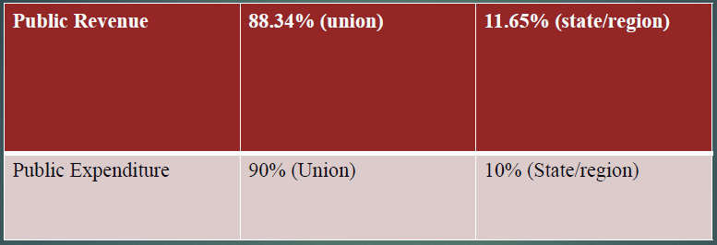
Decentralization in Myamar
Source: THIRI AUNG (2019)

Slide 11
Budget Decentralization
Source: Jorge Martinez-Vasquez (2011) and Myanmar Government for the data of Myanmar

Slide 12
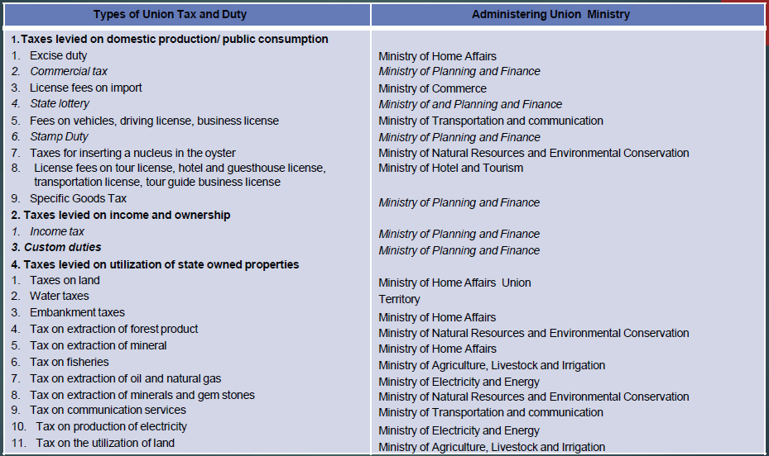
Current Union Tax Structure in Myanmar
Source: THIRI AUNG (2019)

Slide 13
Expenditure Assignments in Myanmar
Sector | Responsible by | Remarks
Foreign Affairs | CG
International Trade | CG
Defense | CG
Police | CG
Monetary Policy | CG
Immigration | CG
Education | CG | progress on deconcentration
Health | CG | progress on deconcentration
Social Welfare | CG
Border Area Development | CG
Fiscal Policy | CG, S&RGs
Planning and Budgeting | CG, S&RGs
Environmental and Natural Resources | CG, S&RGs | merely assignment to S&RGs
Electricity | CG, S&RGs
Highways | CG, S&RGs
Industry and Agriculture | CG, S&RGs
Municipal and Urban Management | S&RGs

Slide 14
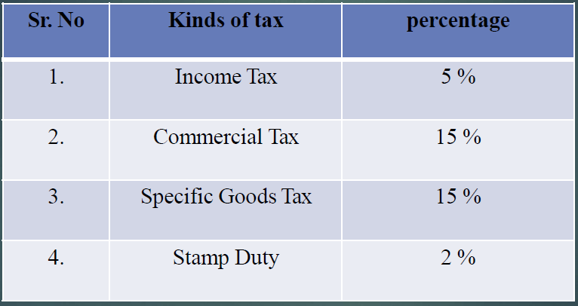
Tax percentage transferred to the local government Fund by IRD
Source: THIRI AUNG (2019)

Slide 15
Taxes Collected by Region or States
1.Land revenue.
2.Excise revenue.
3.Water tax and embankment tax based on dams and reservoirs managed by the Region or State and tax on use of electricity generated by such facilities managed by the Region or State.
4.Toll fees from using roads and bridges managed by the Region or State.
5.(a) Royalty collected on fresh water fisheries.
6.(b) Royalty collected on marine fisheries within the permitted range of territorial water.
7.Taxes collected on vehicles on road transport and vessels on inland waterway transport, in accord with law, in a Region or a State.
8.Proceeds, rent fees and other profits from those properties owned by a Region or a State.
9.Fees, taxes and other revenues collected on services enterprises by a Region or a State.

Slide 16
Taxes Collected by Region or States
9.Fines imposed by judicial courts in a Region or a State including Region Taya
10.Hluttaw or State Taya Hluttaw and taxes collected on service provision and other revenues.
11.Interests from disbursed by a Region or State.
12.Profits returned from investment of a Region or State.
13.Taxes collected on extraction of the following items from the forests in a Region or a State:
9. (a) Taxes collected on all other woods except teak and other restricted hard woods;
10.(b) Taxes collected on firewood, charcoal, rattan, bamboo, birdnests, cutch, thanetkha, turpentine, eaglewood and honey-based products.
14.Registration fees.
15.Taxes on entrainments.
16.Salt tax.
17.Revenue received from the Union Fund Account.
18.Contributions by development affairs organizations in a Region or State concerned.
19.Unclaimed cash and property.
20.Treasure trove.

Slide 17
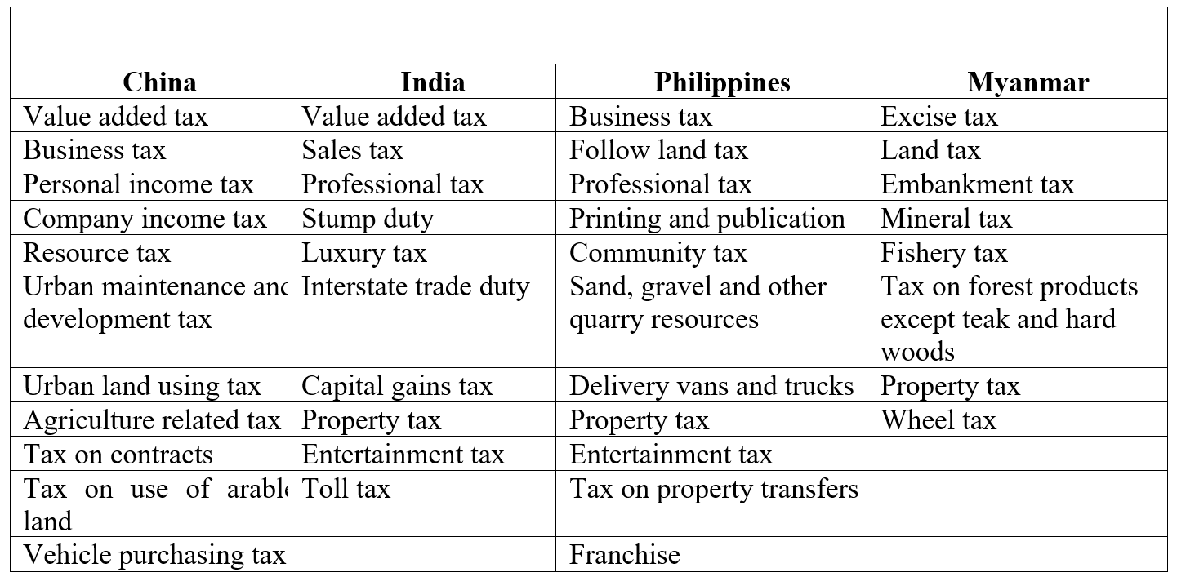
Sub-national Taxes in Selected Countries

Slide 18
Compositions of Revenue by States and Regions in Myanmar

Slide 19
Tax Revenue by types (2016-17) in Myanamar

Slide 20
Revenue and Expenditure per Capita by States/Regions in 2018 (thousand MMK)

Slide 21
Thank you for your attention!
Du T. Huynh
12-2020

