Slide 1
Role of SEEs in Myanmar Economy and the Union’s Public Finance
Huynh The Du

Slide 2
The outline of presentation
Markets and market failures
Roles/functions of the state
Problems make the state in general and SEEs/SOEs inefficient
SEE in Myanmar
Discussion

Slide 3
Market and Market Failures
Competitive Markets
Markets
Monopoly (Incomplete Competition)
Externalities
Public Goods
Asymmetric Information
Irrational Behavior

Slide 4
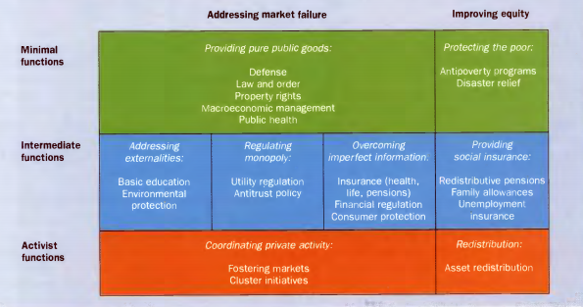
Functions of the State
Source: World Bank (1997)

Slide 5
State Interventions
Providing goods and services
Taxation and/or subsidy
Regulations

Slide 7
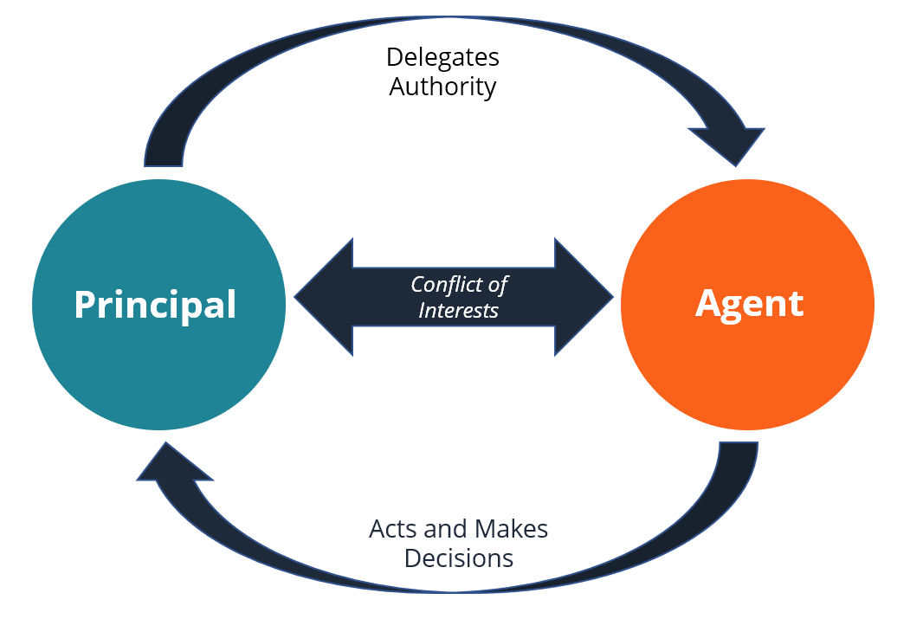
Principal Agent Problem

Slide 8
SOEss/SEE
Confusion between business and political/policy functions
What should be the role of SOE/SEE?

Slide 9
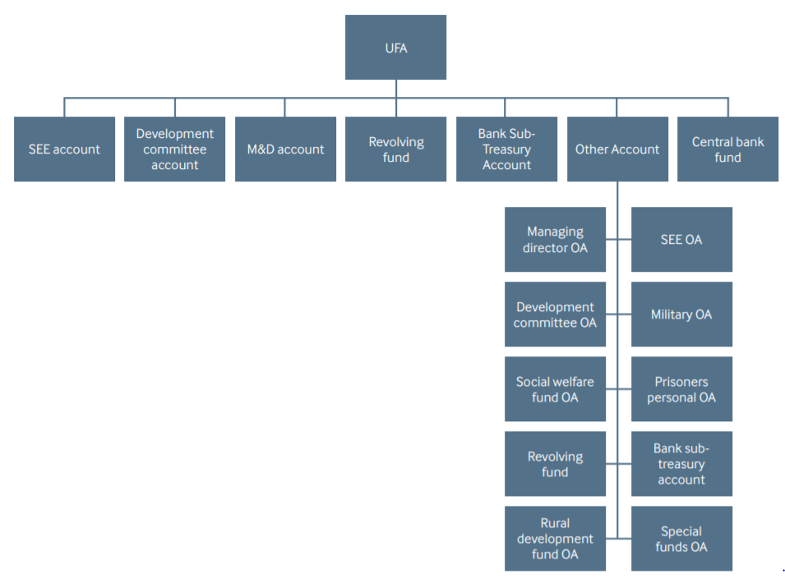
Union Fund Account Structure

Slide 10
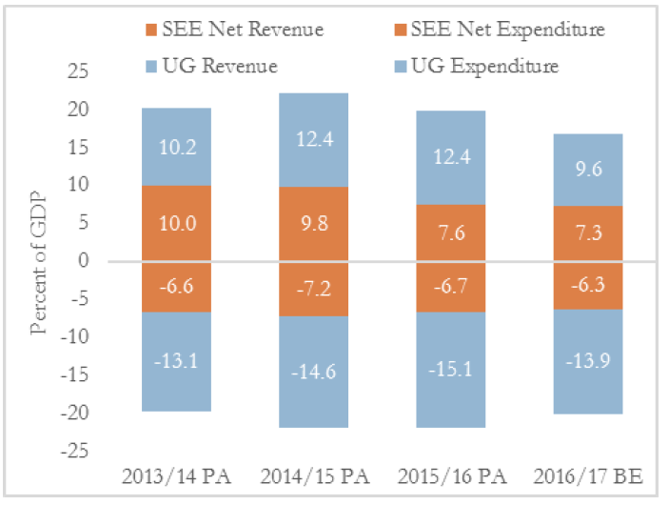
Rev and Exp by the UG and SEE (%GDP)

Slide 11
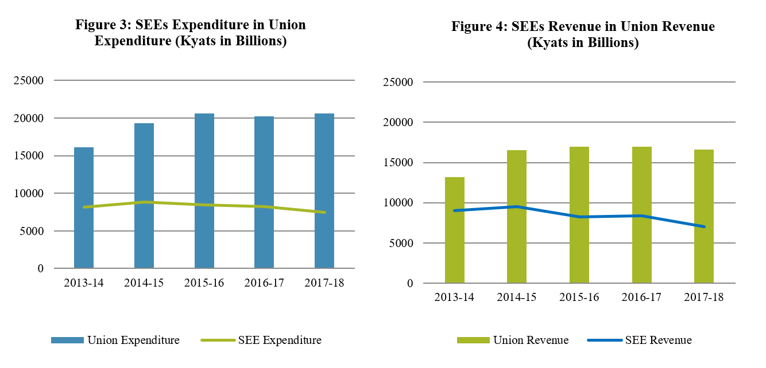
UG and SEEs: Revenues and Expenditures

Slide 12
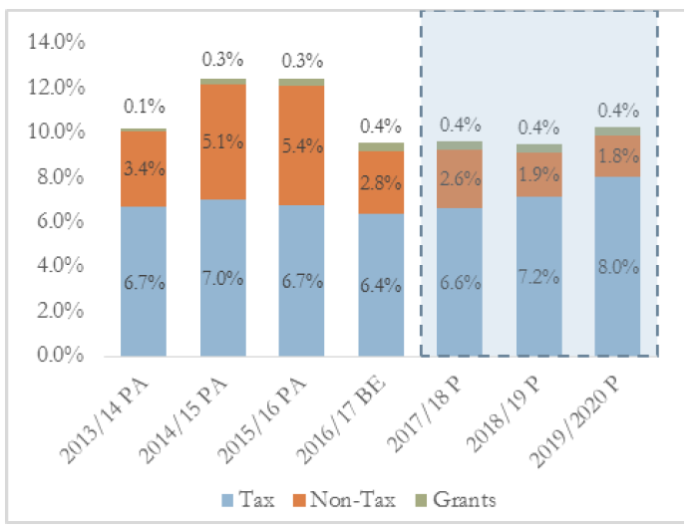
Tax and non-tax revenue

Slide 13
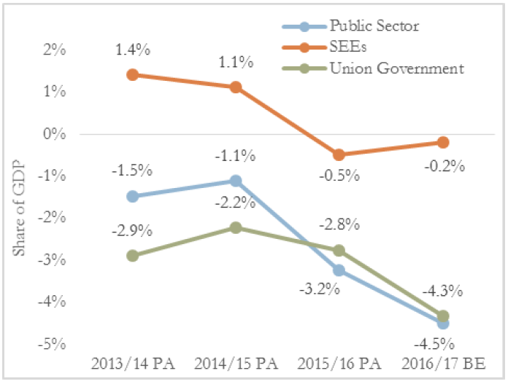
Fiscal Deficit (%GDP)

Slide 14
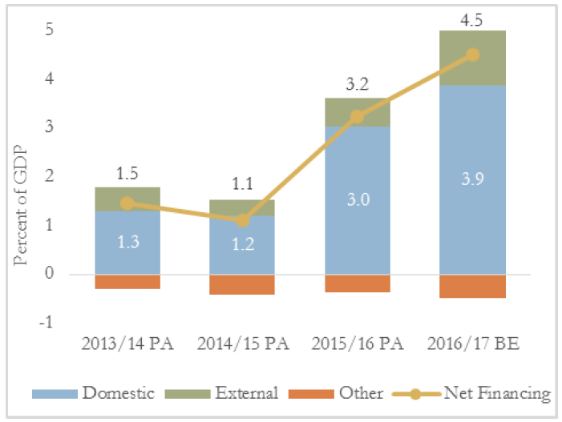
Deficit Financing (%GDP)

Slide 15
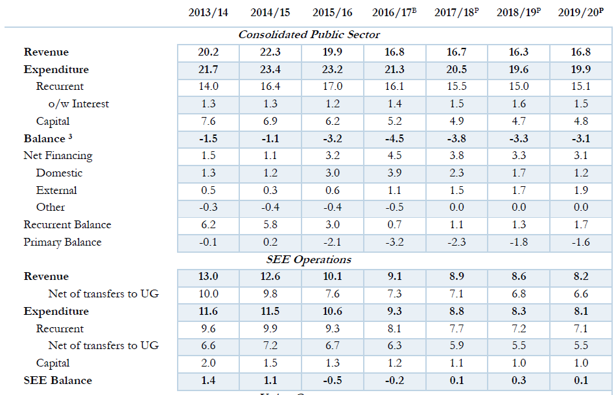
Expenditure Composition (% GDP)

Slide 16
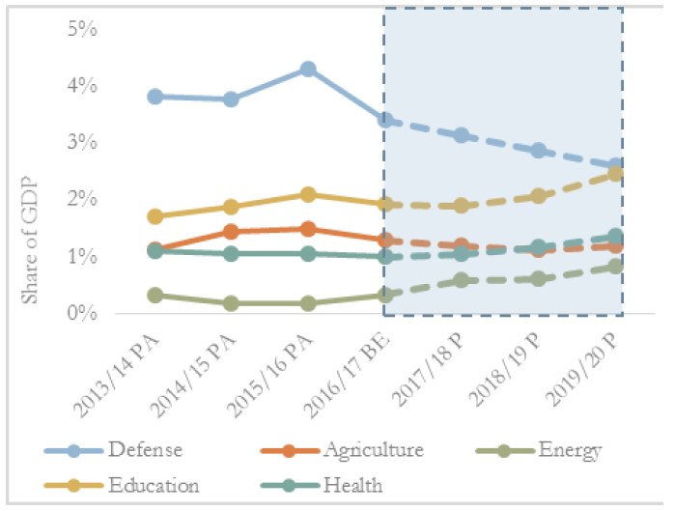
Expenditure Compostions

Slide 17
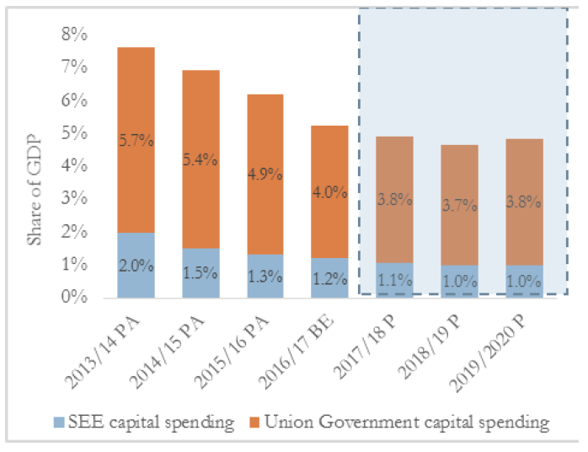
Capital Spending

Slide 18
SEE in Myanmar and Other Countries

Slide 19
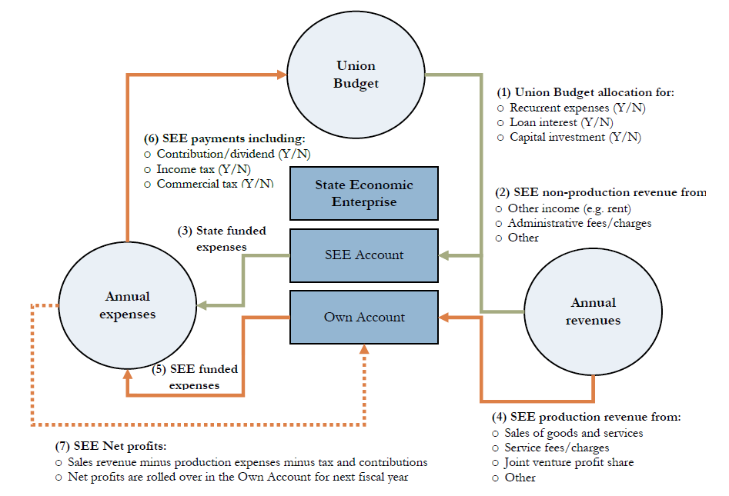
Flow of Funds between Union Budget and SEEs

Slide 20
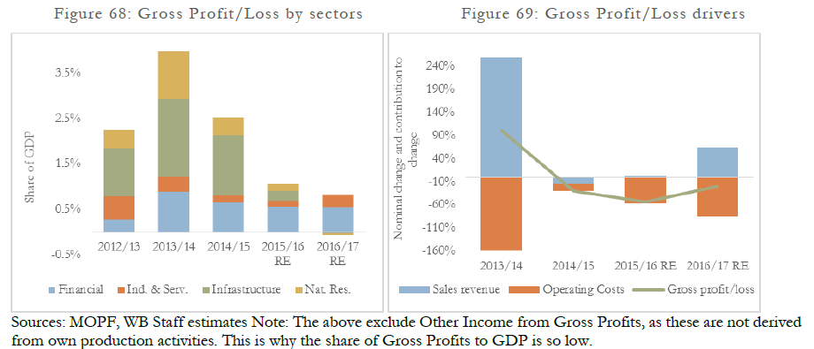

Slide 21
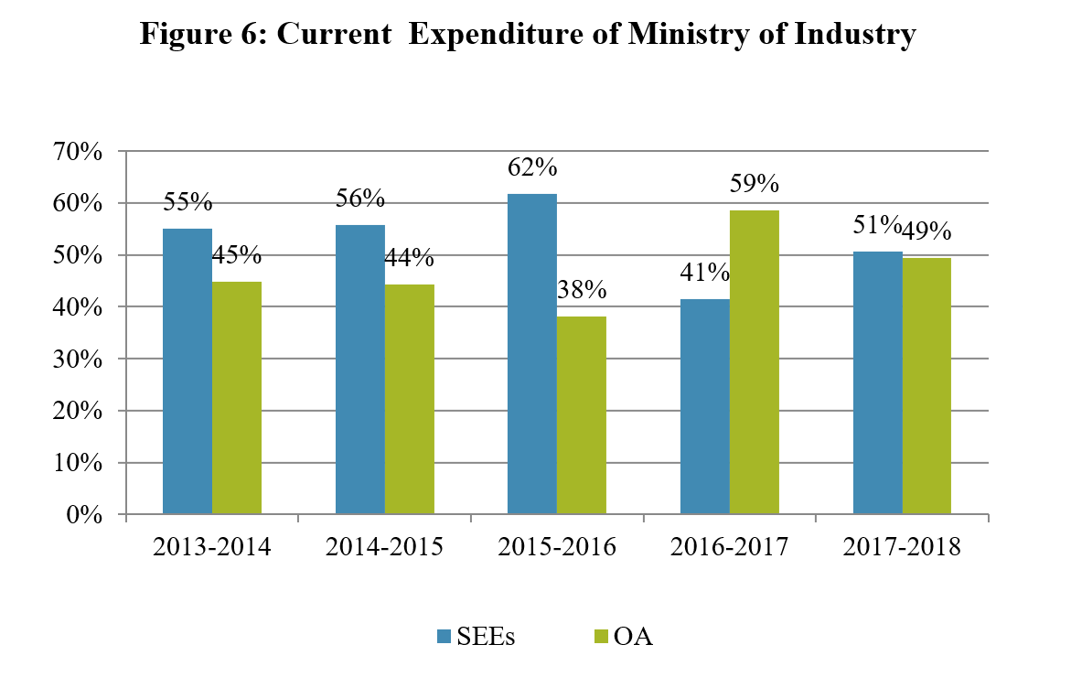

Slide 22
Problems of SEEs in Myanmar
Decline in revenue for organizations which are re-branded as a government department from an enterprise
Weak management
Manufactured products have low quality
Lack of Willingness to innovate
Lack of creativity
Lack of hard work
Lack of Brand name recognition
Lack of competitiveness in price and quality compared to imported goods
Lack of a well-functioning market
Salary and Pension expenses for superfluous labor force
Laws and Regulations regarding SEEs are almost non-existent
Laws and by-laws for protecting and promoting businesses are weak

Slide 23
Discussions
The role of SEE/SOE
Central and local SOEs: Experiences from China and Vietnam
SEE reform
Transparency: Functions and accounting system and
Marketization (competition and ownership)

