Slide 1
Case Studies from Bago Region and Shan State
Huynh The Du

Slide 2
Budget Expenditure to GDP (%)
Source: Our World in Data
Some Asian Countries
Myanmar
Source: Our World in Data from 1998-2011 and World Bank (2017) from 2013-2016

Slide 3
Budget Decentralization
Source: Vietnam’s Ministry of Finance

Slide 4
Expenditure Assignments in Myanmar
Sector | Responsible by | Remarks
Foreign Affairs | CG
International Trade | CG
Defense | CG
Police | CG
Monetary Policy | CG
Immigration | CG
Education | CG | progress on deconcentration
Health | CG | progress on deconcentration
Social Welfare | CG
Border Area Development | CG
Fiscal Policy | CG, S&RGs
Planning and Budgeting | CG, S&RGs
Environmental and Natural Resources | CG, S&RGs | merely assignment to S&RGs
Electricity | CG, S&RGs
Highways | CG, S&RGs
Industry and Agriculture | CG, S&RGs
Municipal and Urban Management | S&RGs

Slide 5
Shares of the Subnational Revenues
Source: Shan’s policy brief

Slide 6
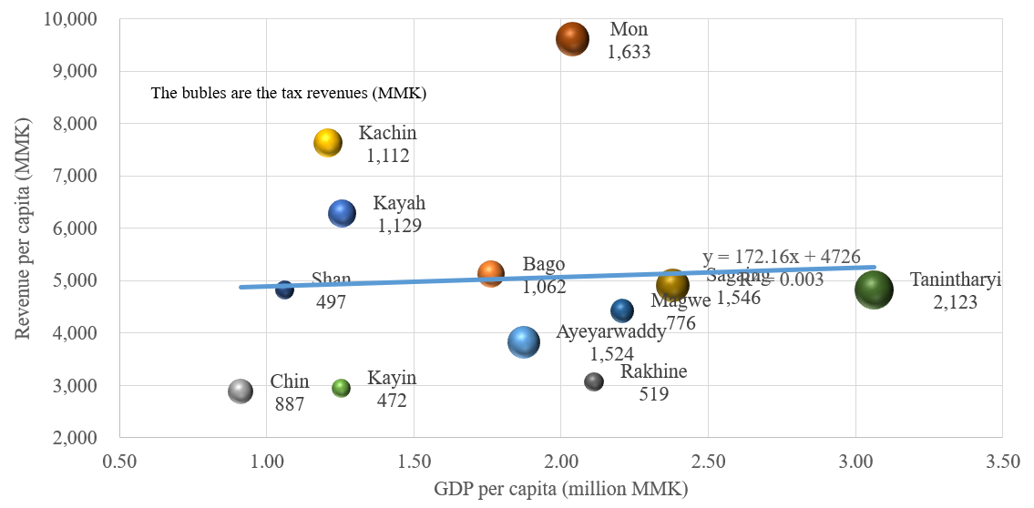
GDP, Total Revenue and Tax Revenue per Capita by States and Regions

Slide 7
Compositions of Revenue by States and Regions in Myanmar

Slide 8
Revenue and Expenditure per Capita by States/Regions in 2018 (thousand MMK)

Slide 9
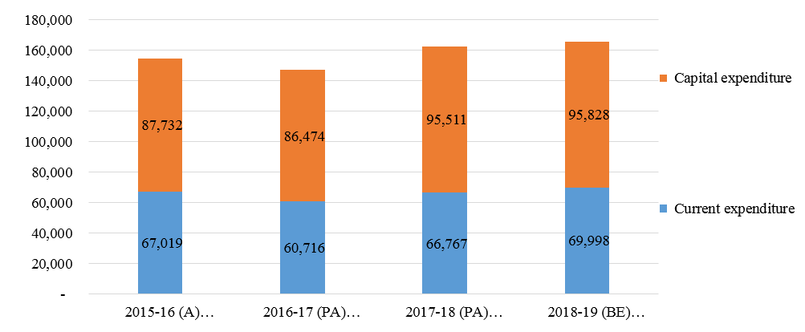
Expenditure Structure in Bago Region (Million MMK)
Source: Bago’s policy brief

Slide 10
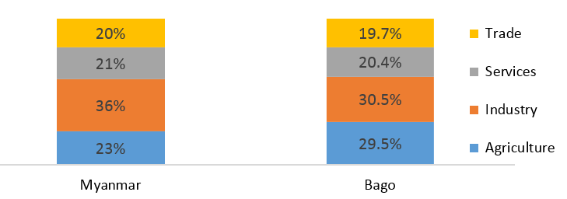
The GDP composition of Myanmar and Bago in 2018-19

Slide 11
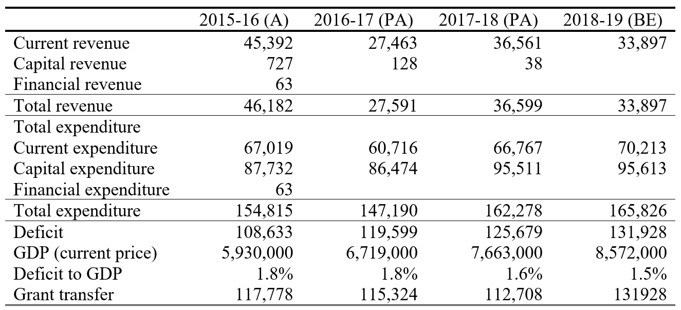
Fiscal positions of regional government (Million MMK)

Slide 12
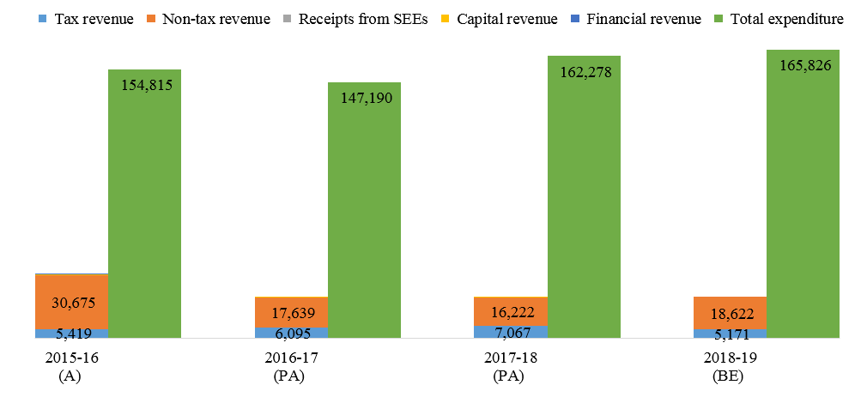
Own revenue and expenditure

Slide 13
Expenditure Structure in Bago Region (Million MMK)

Slide 14
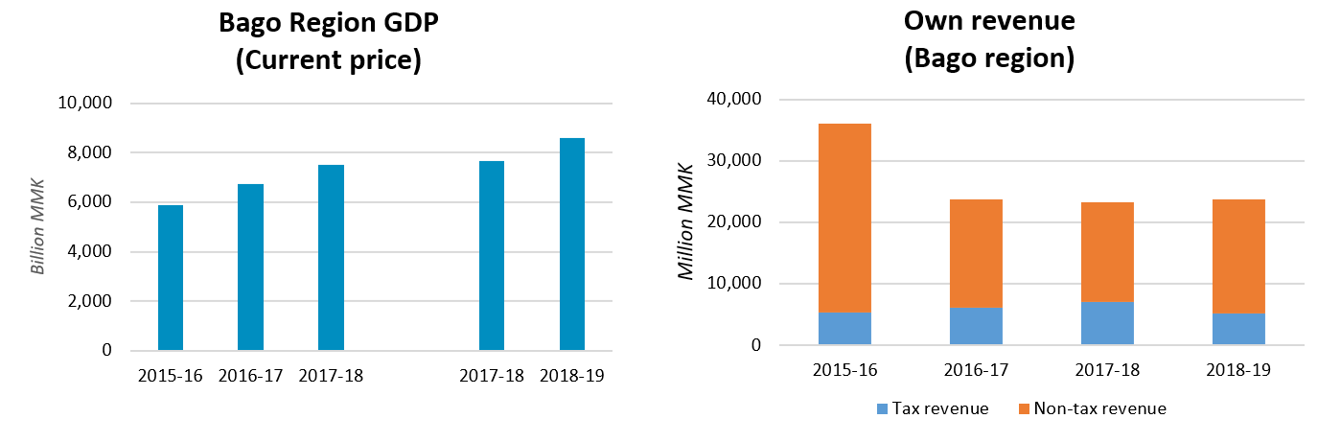
Bago’s GDP and Own Revenue

Slide 15
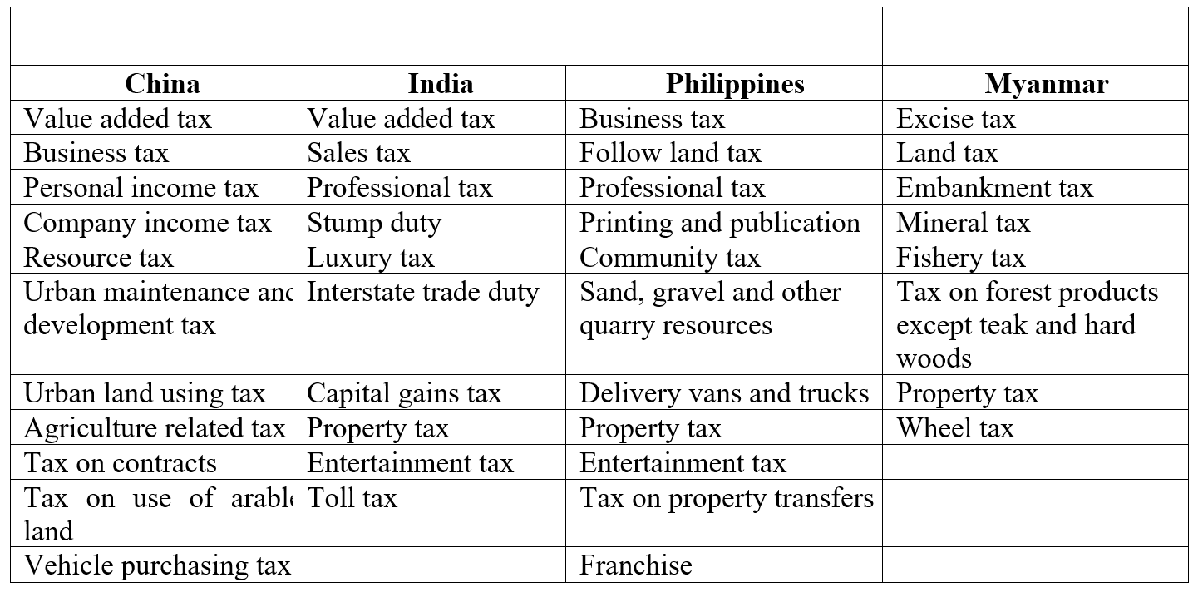
Sub-national Taxes in Selected Countries and Myanmar

Slide 16
Tax Revenue by types (2016-17) in Myanamar

Slide 17
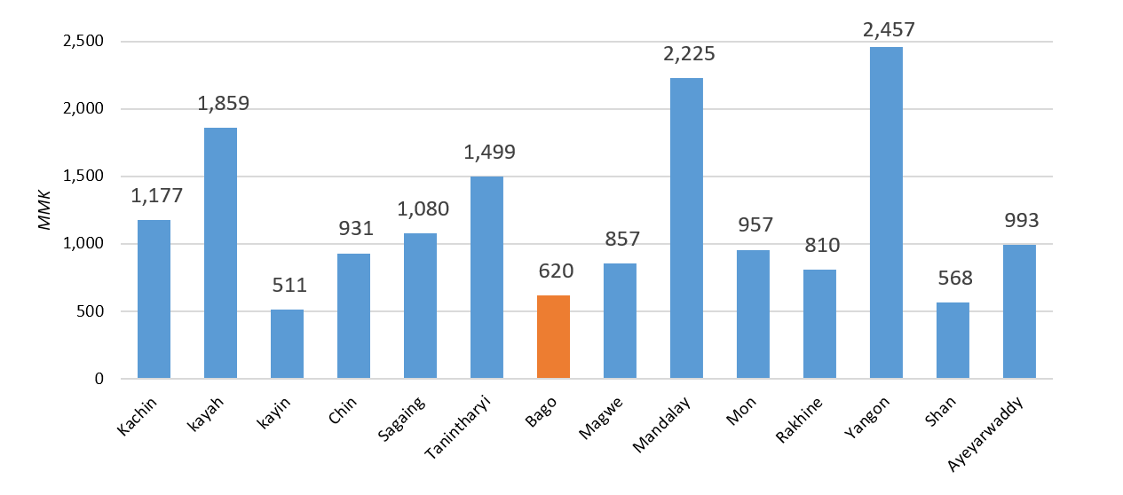
Property tax (DAOs) Paid by Individual Urban Residents

Slide 18
Revenue Sources in Bago Region

Slide 19
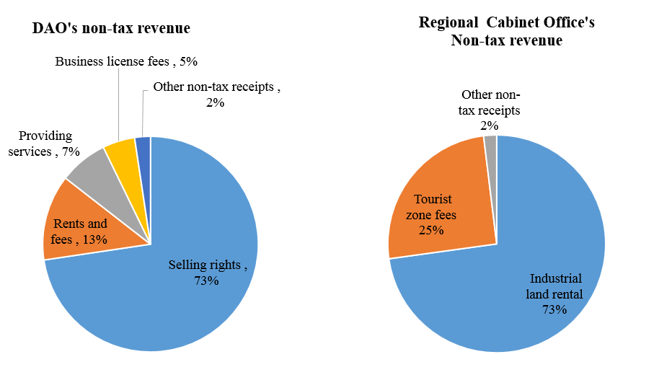
Non-tax Revenues of DOA and Regional Cabinet Office

Slide 20
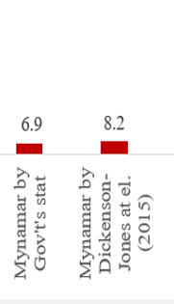
Recommendation for Myanmar
Decentralization
in Myanmar
Sector | Responsible by | Remarks
Foreign Affairs | CG
International Trade | CG
Defense | CG
Police | CG
Monetary Policy | CG
Immigration | CG
Education | CG | progress on deconcentration
Health | CG | progress on deconcentration
Social Welfare | CG
Border Area Development | CG
Fiscal Policy | CG, S&RGs
Planning and Budgeting | CG, S&RGs
Environmental and Natural Resources | CG, S&RGs | merely assignment to S&RGs
Electricity | CG, S&RGs
Highways | CG, S&RGs
Industry and Agriculture | CG, S&RGs
Municipal and Urban Management | S&RGs
Decentralization in Vietnam
Source: Vietnam’s Ministry of Finance

Slide 21
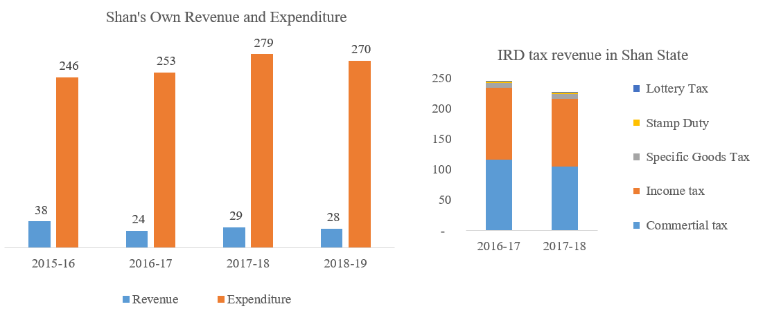
Shan’s Rev and Exp and IRD Tax Rev in Shan (Billion MMK)

Slide 22
Shan’s Expenditure Structure (billion MMK)

Slide 23
Four Considerations from the Shan State’s Case
First, drawing a clear dividing line on assignments.
Second, promoting local revenue generation.
Third, improving the transfer mechanism.
Fourth, improving government expenditure allocation.

Slide 24
Thank you for your attention!
Nguyen Xuan Thanh

